Slide 1

DetactaX AI
DEPI Round 3 Graduation Project

Slide 2

Project team:
Zyad Gamal (team leader): Azure Integration & API Deployment.
Basel Mohamed Mostafa: Classification Models Baseline & Car Classifier structure & Training, Mlflow, and Project Documentation.
Omar Yasser: Project Models Interface GUI using Streamlit.
Mohamed Elfouly: Object Recognition Model.
Zyad Ahmed: Dataset Acquistion & Augmentations.
Abdulrahman: Baseline Classifer Transfer Learning.

Slide 3
Introduction:
Existing tools are complex or slow and require technical expertise.
Users need:
1. Easy-to-use interface
2. Quick predictions
3. High accuracy
4. No technical setup required
- Project Idea: Making a website with both Image Classification & Object Recognition capabilities for multi-use cases.
- Goal: Quickly and accurately classify the main object in an image & recognize multiple objects using top of the line models.

Slide 4
Classification Model Structure

Slide 5
Classifiers:
Models used:
1. MobileNetV2.
2. EfficientNet-B0.
Both models are employed for different use-cases in our project, where:
MobileNetV2 is used as a baseline test general classifier.
EfficientNet-B0 used for Intelligent Transportation systems.

Slide 6
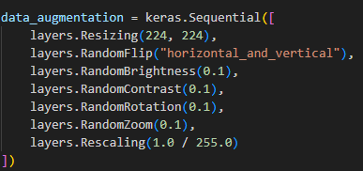
General Classifier (Base-line/Control):
Model Used: MobileNetV2 trained on the CIFAR-10 Dataset.
Dataset Details:
The CIFAR-10 dataset consists of 60000 32x32 color images in 10 classes, with 6000 images per class. There are 50000 training images and 10000 test images.
Augmentations Applied on the Dataset:
Resizing to 224x224.
Random Flip Horizontal and Vertical.
Random Brightness.
Random Contrast.
Random Rotation.
Random Zoom.
Rescaling (1/255).

Slide 7
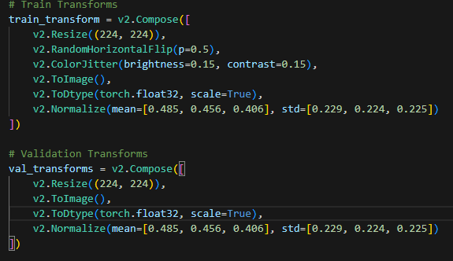
Intelligent Transportation System (Main Classifier):
Model Used: EfficientNet-B0 trained on the CUHK-Compcars dataset.
Dataset Details:
Contains 163 car makes with 1,716 car models. There are a total of 136,726 images. The full car images are labeled with bounding boxes and viewpoints.
Augmentations Applied:
1. Image Resize.
2. Color Jitter.
3. Normalization
4. Random Horizontal Flipped.

Slide 8
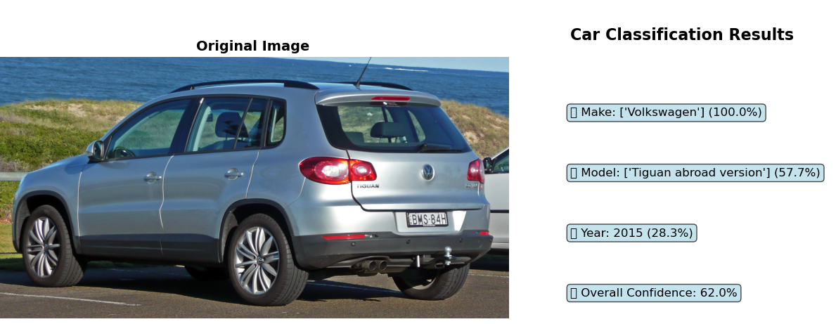
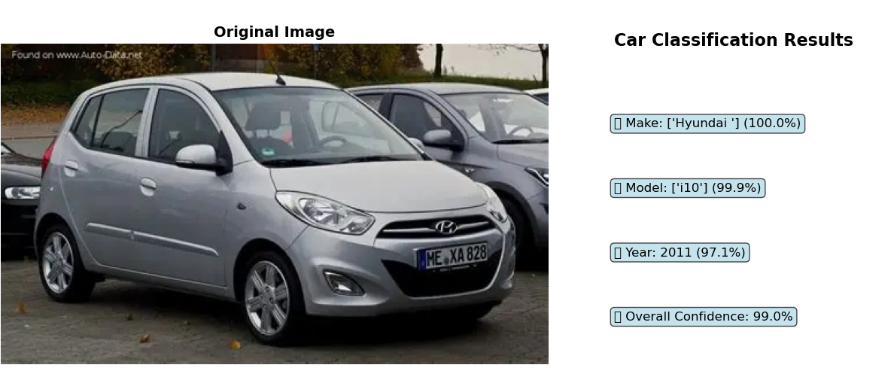
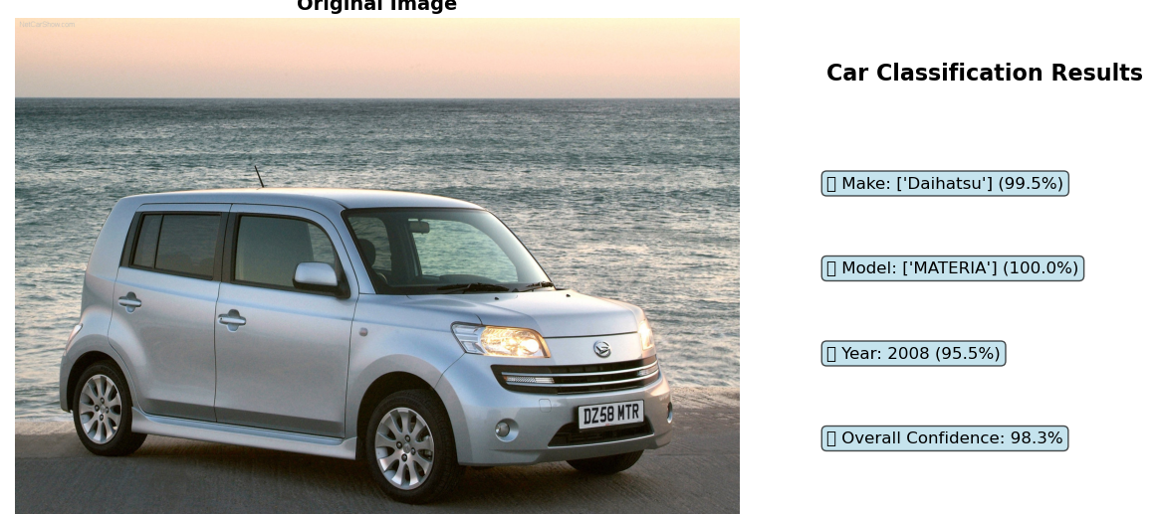
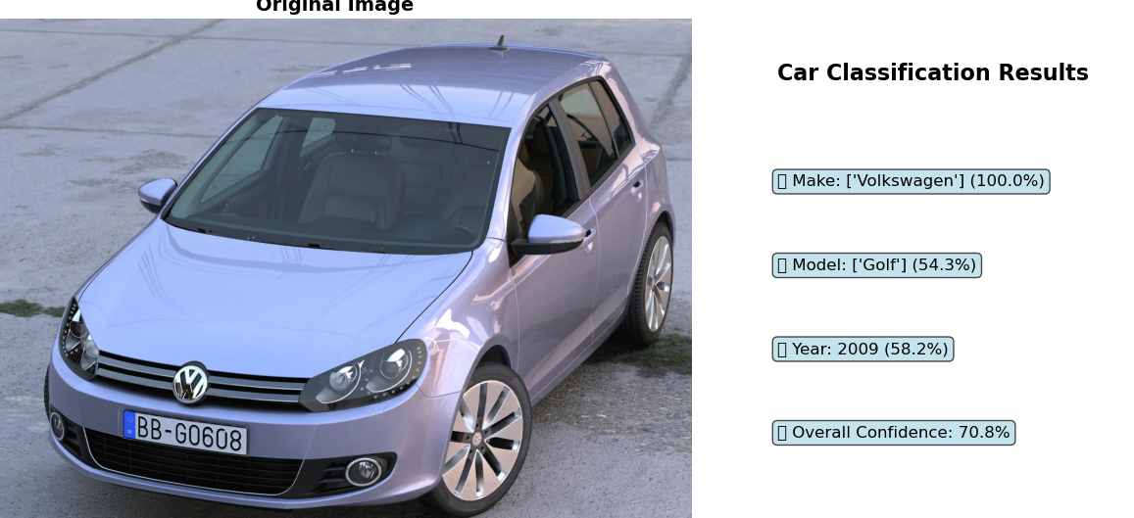

Slide 10

Models Specifications:
Training Cycles:
20 Epochs training cycle with Validation stages in-between for Baseline Classifier (MobileNetV2), Training Took about 6 Hours.
18 Epochs training cycle with Validation stages in-between for Main Car Classifier (EifficientNet-B0), Training took about 11 Hours.
Final Models Results:
Accuracy: 0.8451, Loss: 0.4446, Val Accuracy: 0.8404.

Slide 11
Mlflow

Slide 12
Key Mlflow Components:
MLflow: Central experiment tracker.
Local SQLite: Development tracking database.
Custom Monitors: Production performance tracking and metrics documenting.
Azure Integration: Cloud deployment bridge for easy model redeployment to Azure.

Slide 13
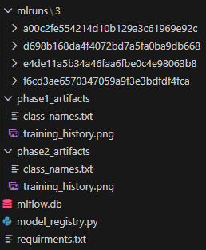
Results & Metrics:
Classification Model Performance
1. Final Test Accuracy: 82%
2. Training Time: ~60 minutes (with MLflow tracking)
3. Model Versions: 3+ registered versions
4. Experiments Tracked: 10+ complete runs
Monitoring System
1. Prediction Tracking: Real-time with <100ms overhead
2. Data Collected: Parameters, metrics, artifacts, predictions
11/29/2025

Slide 14
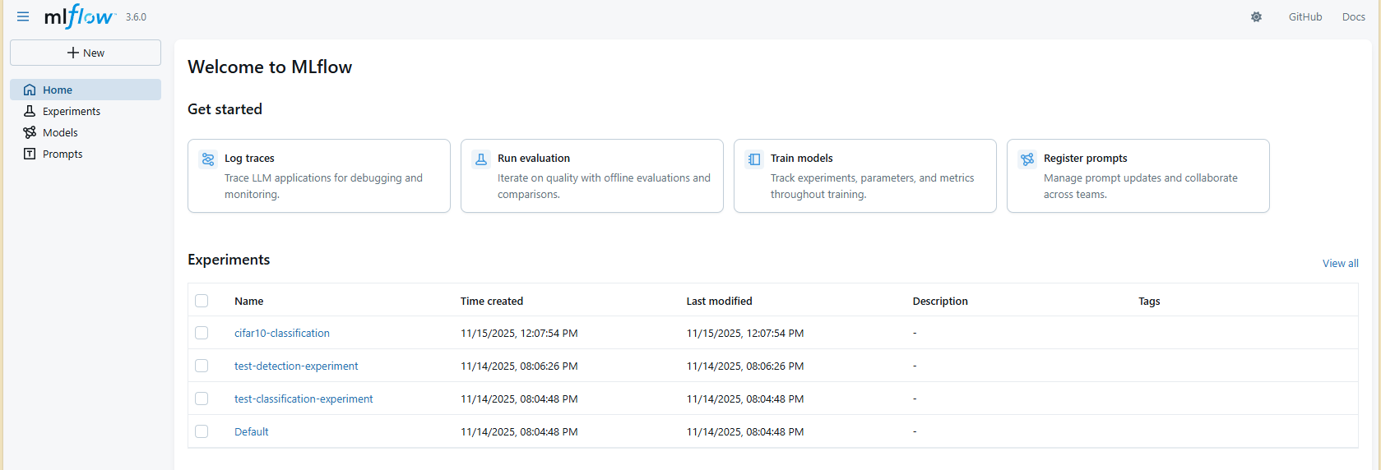

Slide 15
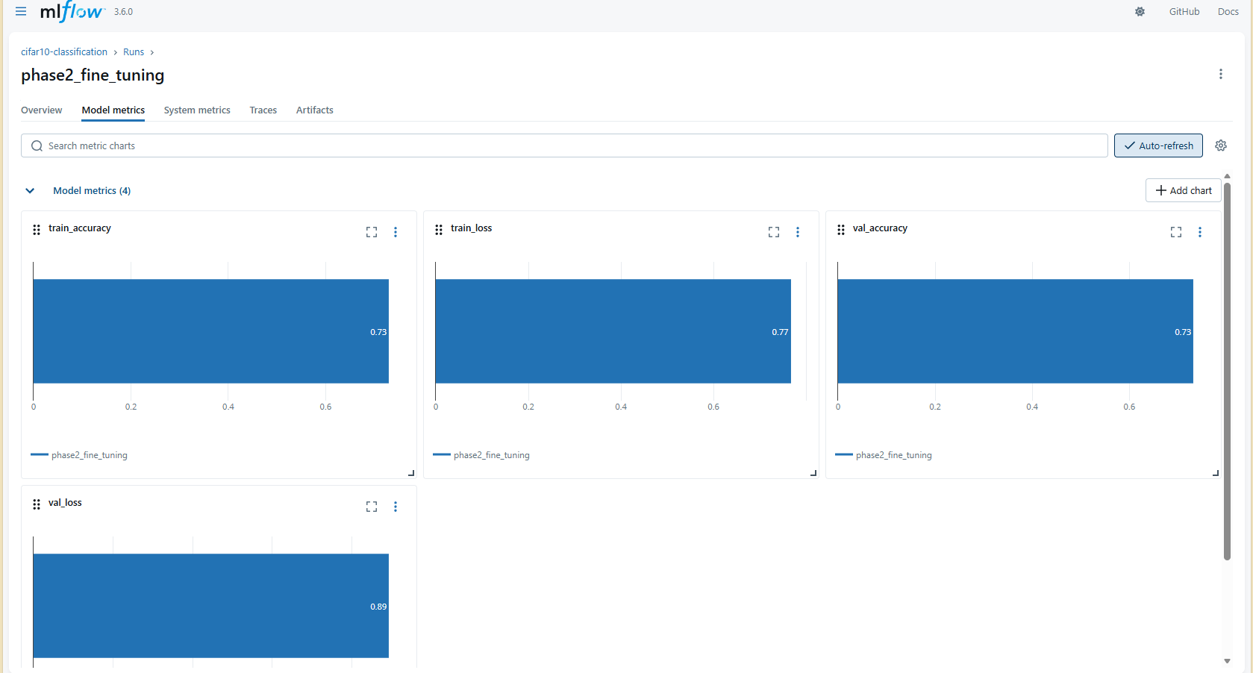

Slide 16
Object Recognition Model

Slide 17
Model Details:
Object Detection system using a pre-trained YOLO model (yolov12x.pt) from the Ultralytics library. The goal was to build a model capable of detecting and classifying multiple objects in images with high accuracy and fast inference speed.
Model Setup and Evaluation
to measure its performance. The evaluation automatically generated detection results and key metrics including:
mAP@0.5 – Measures the overlap quality between predicted and ground-truth bounding boxes.
mAP@0.5:0.95 – A stricter score averaged across 10 IoU thresholds.
Precision – Percentage of predicted boxes that are correct.
Recall – Percentage of actual objects successfully detected.
These metrics provide a full understanding of both accuracy and robustness of the object detection model.

Slide 18
Model Details:
Key Code Operations:
1)Load YOLO model:
model = YOLO("yolov12x.pt")
2) Run validation on COCO128:
metrics = model.val(data="coco128.yaml", imgsz=640)
3) Display sample detection results:
display(Image(filename=img_path))
4) Export structured performance report:
with open("model_evaluation_report.txt", "w") as f:
f.write(report)]
11/28/2025

Slide 19
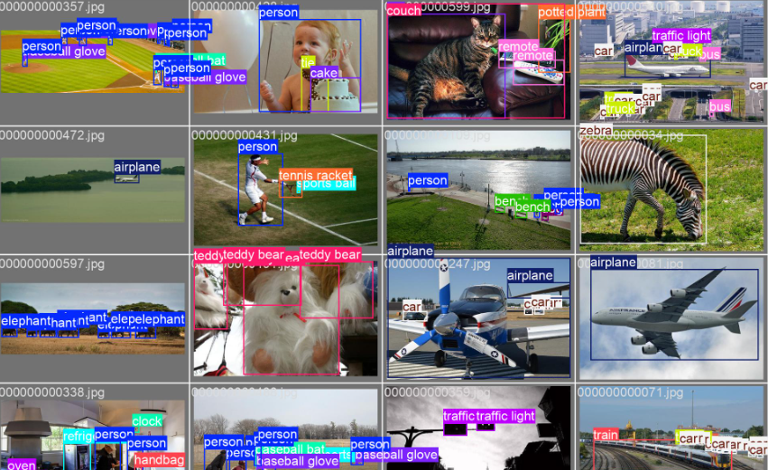
Summary
The YOLOv12x model successfully completed object detection on the validation data, generating reliable performance scores and visual outputs. The evaluation report summarizes the model’s strength in identifying objects with strong precision the project requirements for a trained and evaluated object detection system.
and recall, meeting
11/28/2025

Slide 20

Model Deployment
11/28/2025

Slide 21
Why Deploy?
Make the model accessible to real users
Deliver predictions instantly and at scale
Integrate the system into real workflows
Ensure consistent, reliable performance
11/28/2025

Slide 22
Why Azure?
Reliable cloud infrastructure
Easy model deployment with Azure ML
Scalable compute for heavy workloads
Built-in security and compliance
11/28/2025

Slide 23
Web Interface (Frontend & API Integration)
11/28/2025

Slide 24
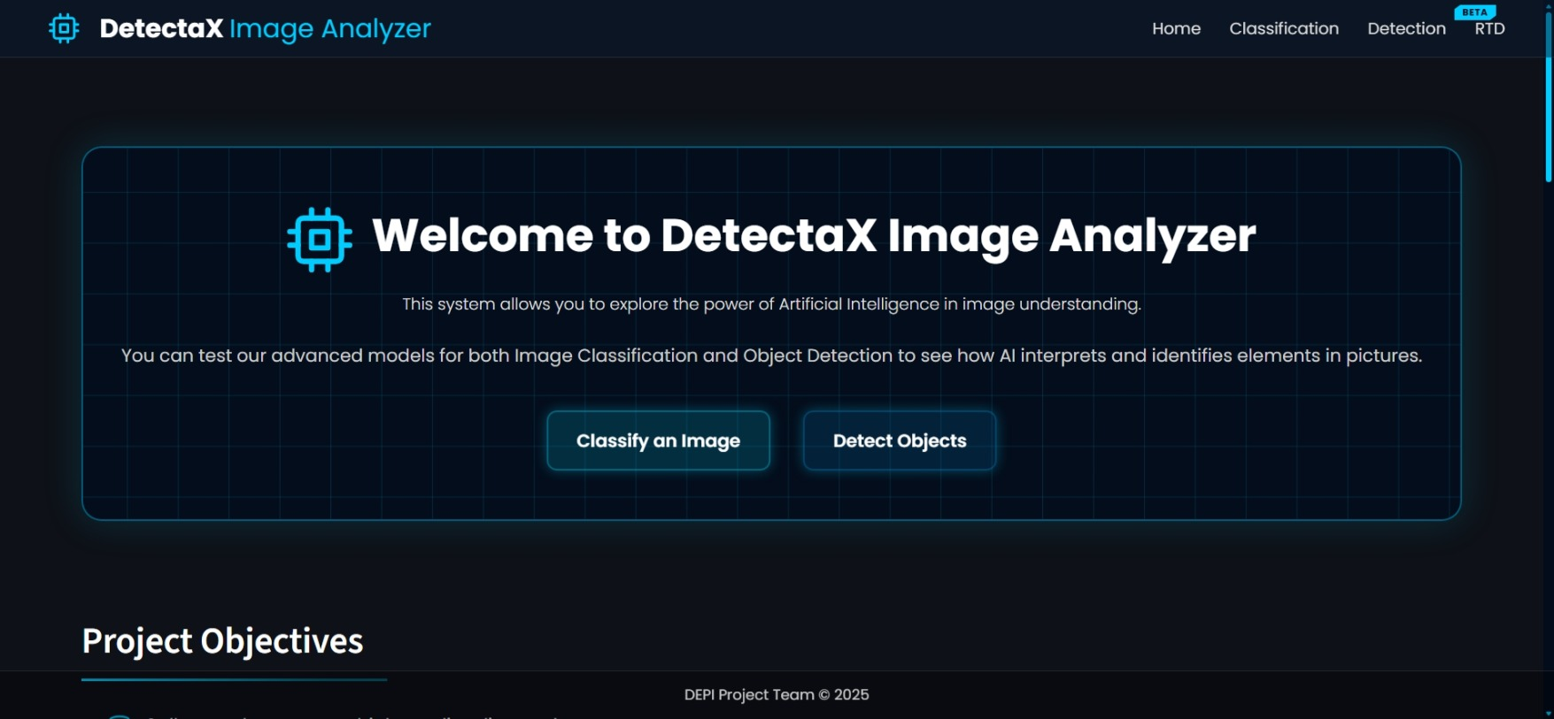
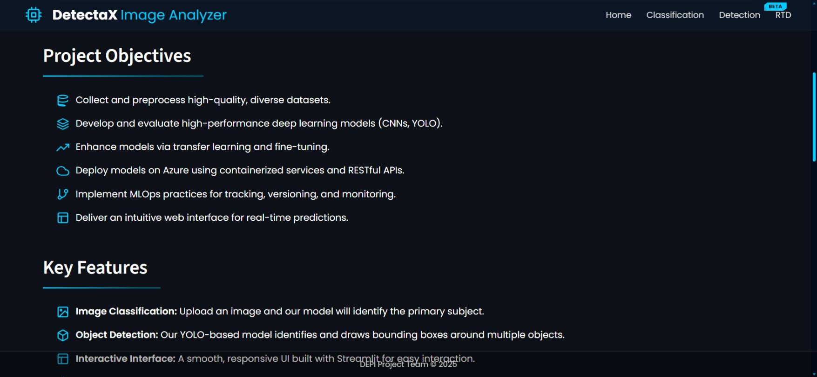
Web Interface Overview
Full interactive web interface built with Streamlit.
Supports image upload, batch processing, camera streaming, and real-time detection.
Unified dark glassmorphism theme with custom CSS.
Smooth navigation and consistent UI design across all modules.
11/28/2025

Slide 25
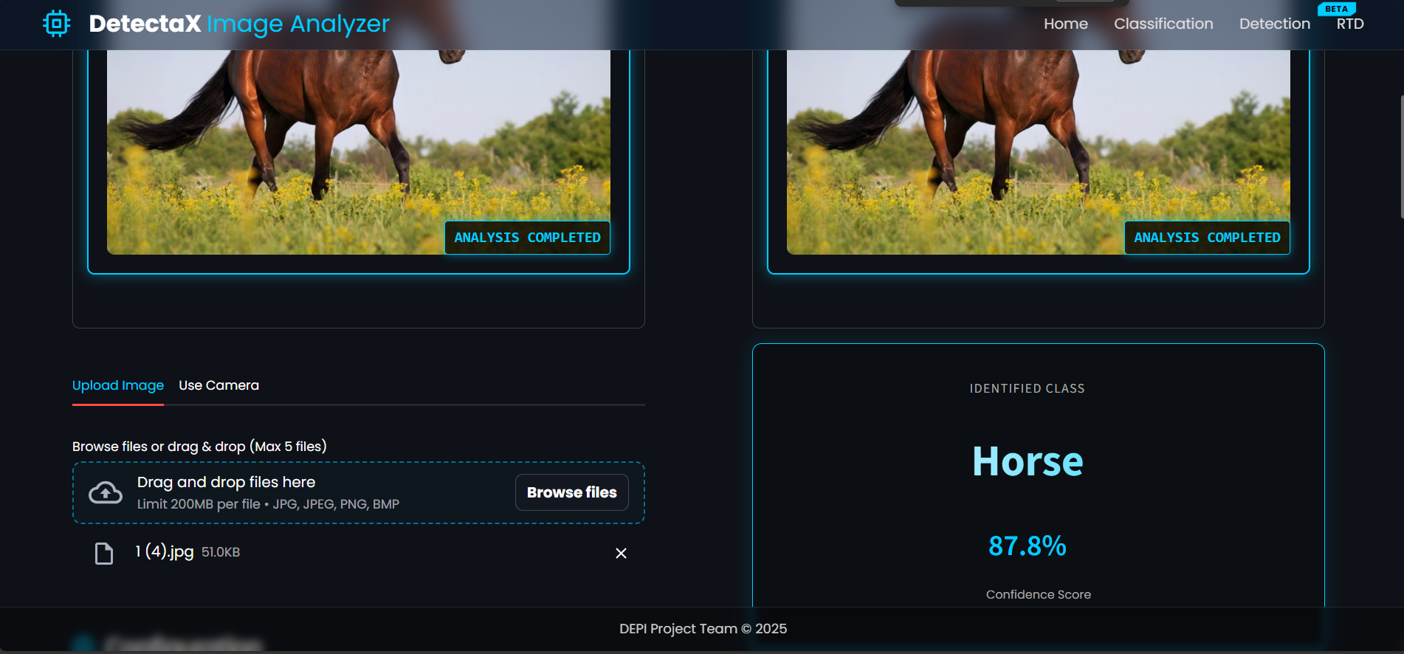
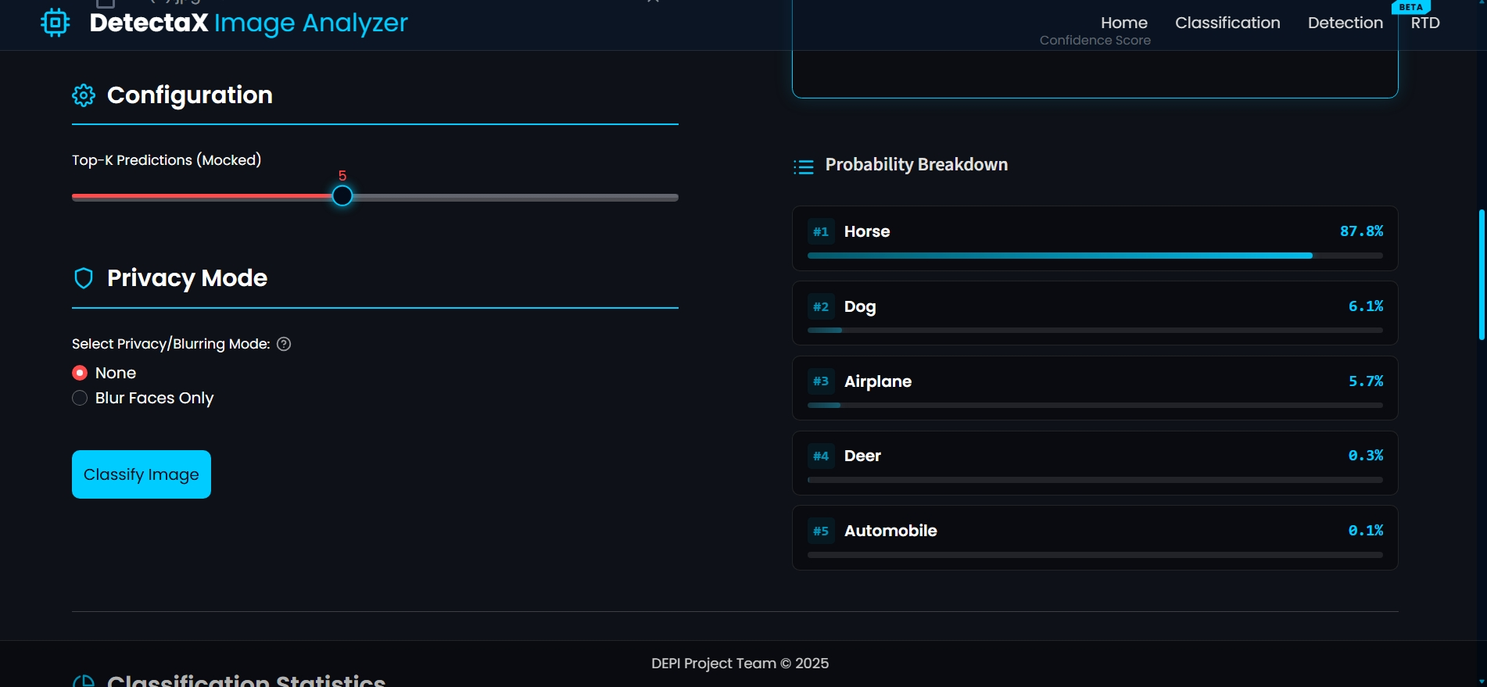
Image Classification Module
Upload single or multiple images (Batch Processing).
Automatic preprocessing and validation of all images.
Sends images to Azure CNN classification endpoint.
Displays predicted class, confidence score, and analytical charts.
Session history maintained for all processed images.
Stable fallback logic for handling API downtime.
11/28/2025

Slide 26
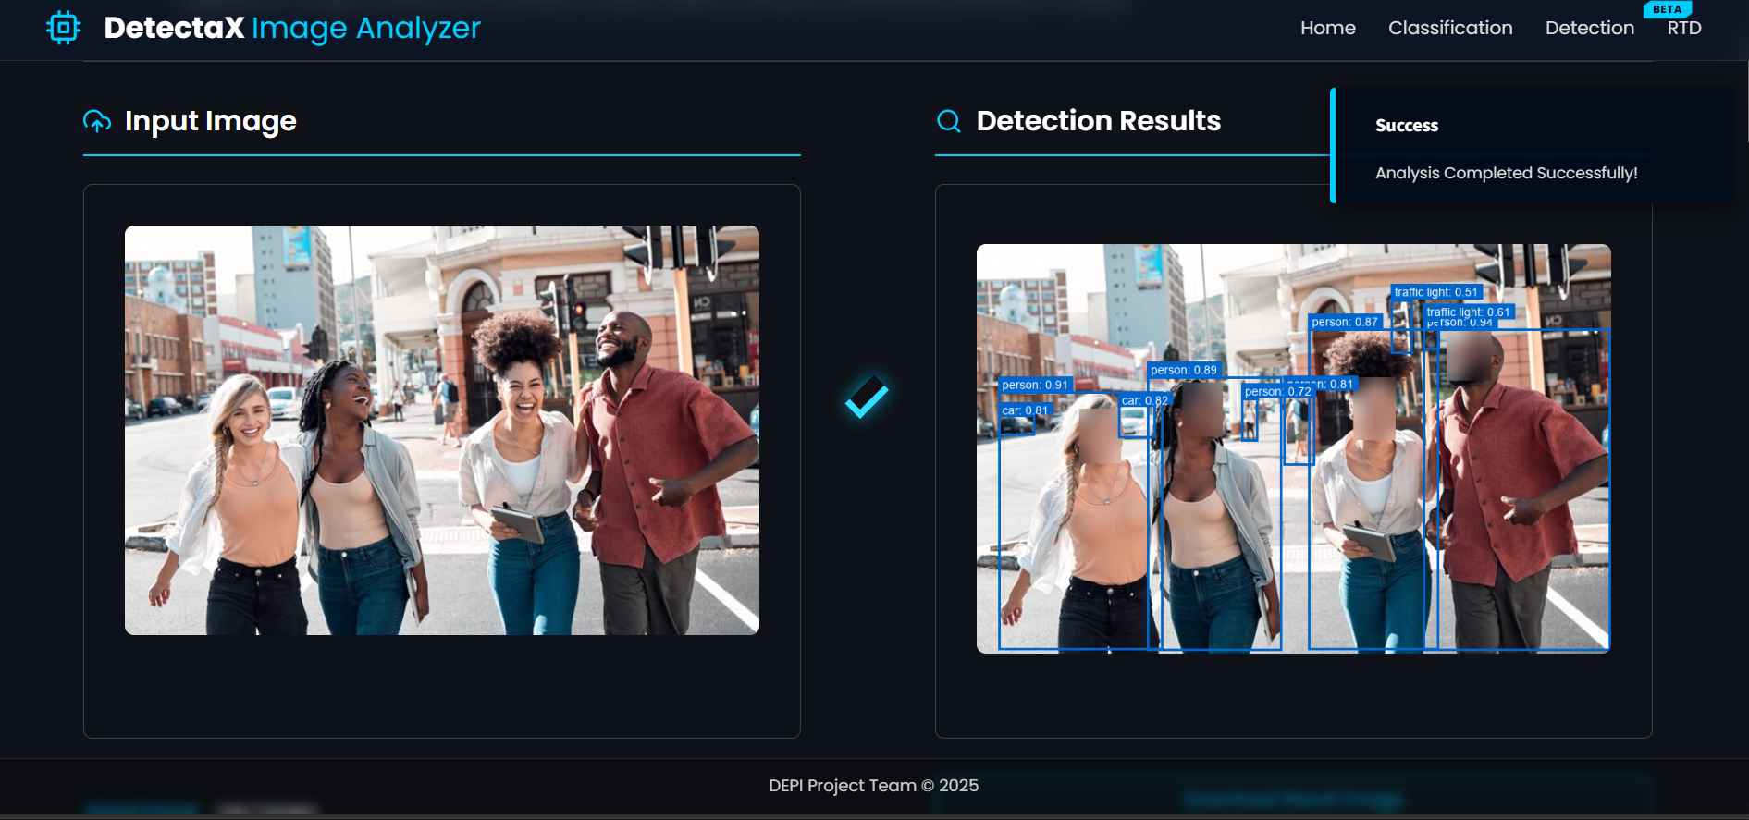
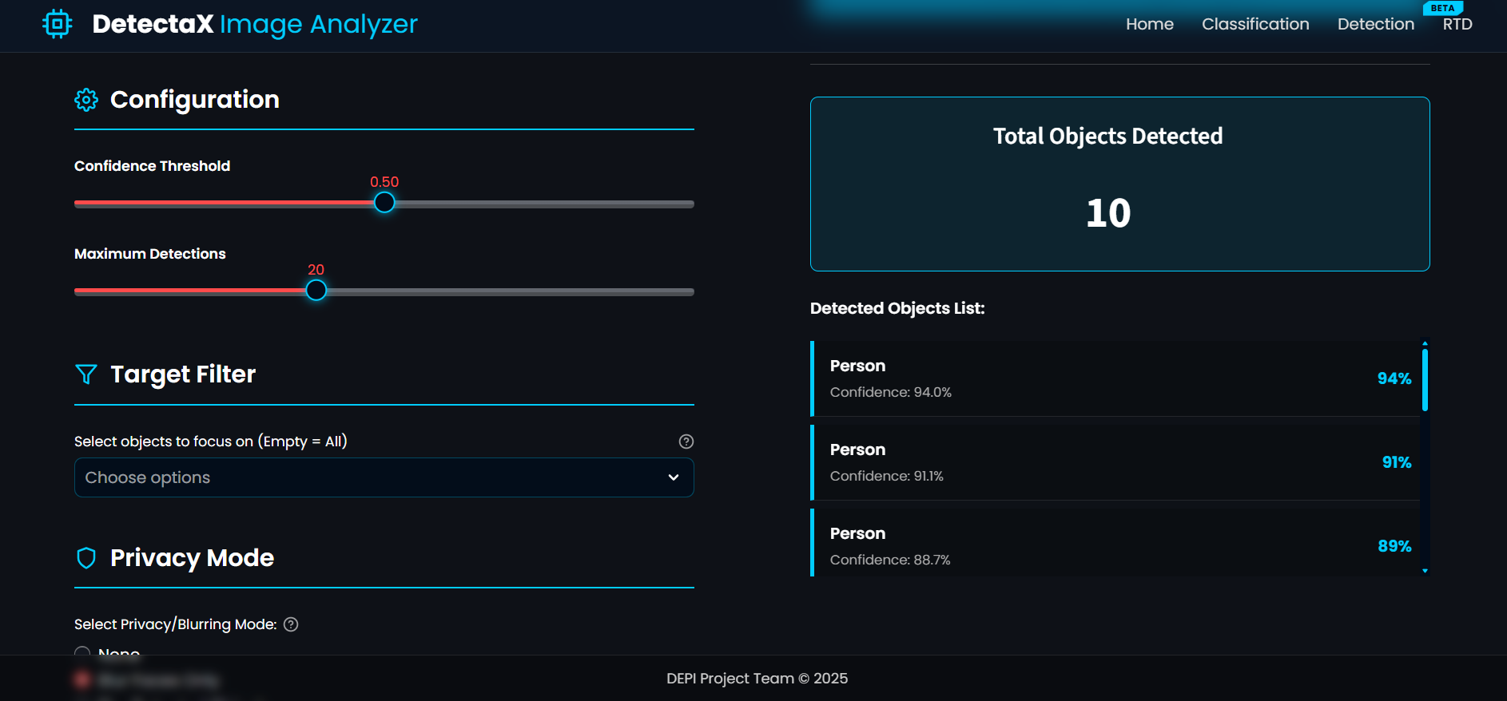
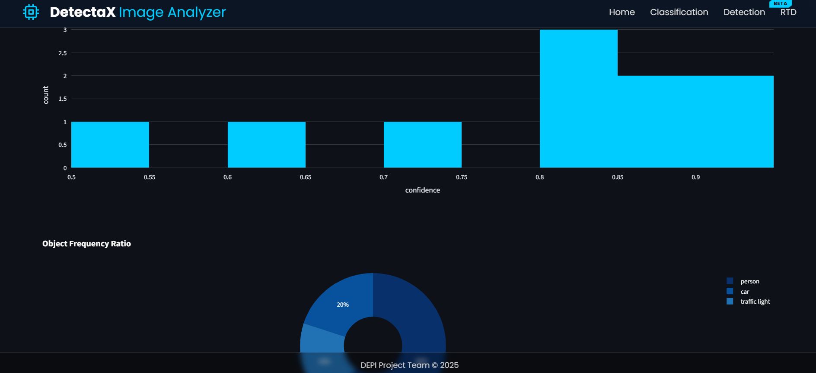
Object Detection Module
Supports single-image and multi-image detection (Batch Processing).
Performs detection using YOLOv12x via Azure cloud endpoint.
Adjustable confidence threshold and class filtering.
Custom bounding-box visualization with class-based colors.
Object cropping, ZIP export, PDF reporting, and detection analytics.
Clean, guided workflow for processing multiple images sequentially.
11/28/2025

Slide 27
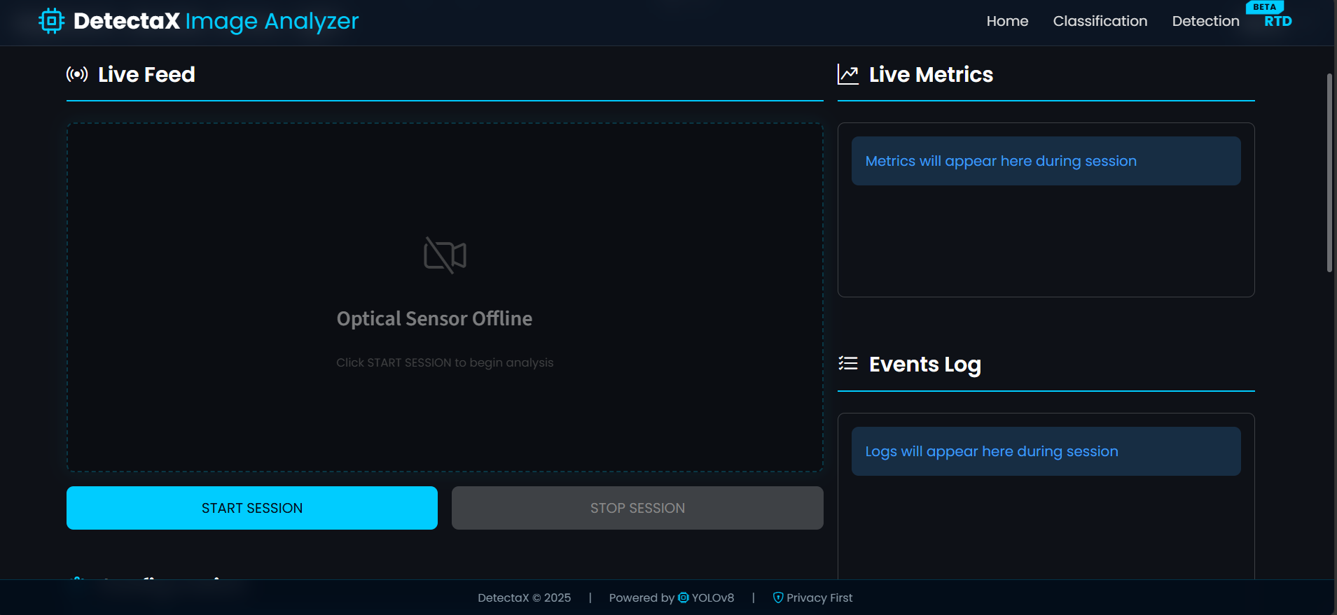
Real-Time Detection (RTD)
Real-time camera feed processing using OpenCV.
Continuous YOLOv12x inference per frame with FPS calculation.
Auto-snapshot capturing during the session.
Live statistics and dynamically updated charts.
11/28/2025

Slide 28
Real-Time Detection (RTD)
Real-time camera feed processing using OpenCV.
Continuous YOLOv12x inference per frame with FPS calculation.
Auto-snapshot capturing during the session.
Live statistics and dynamically updated charts.
11/28/2025

Slide 29
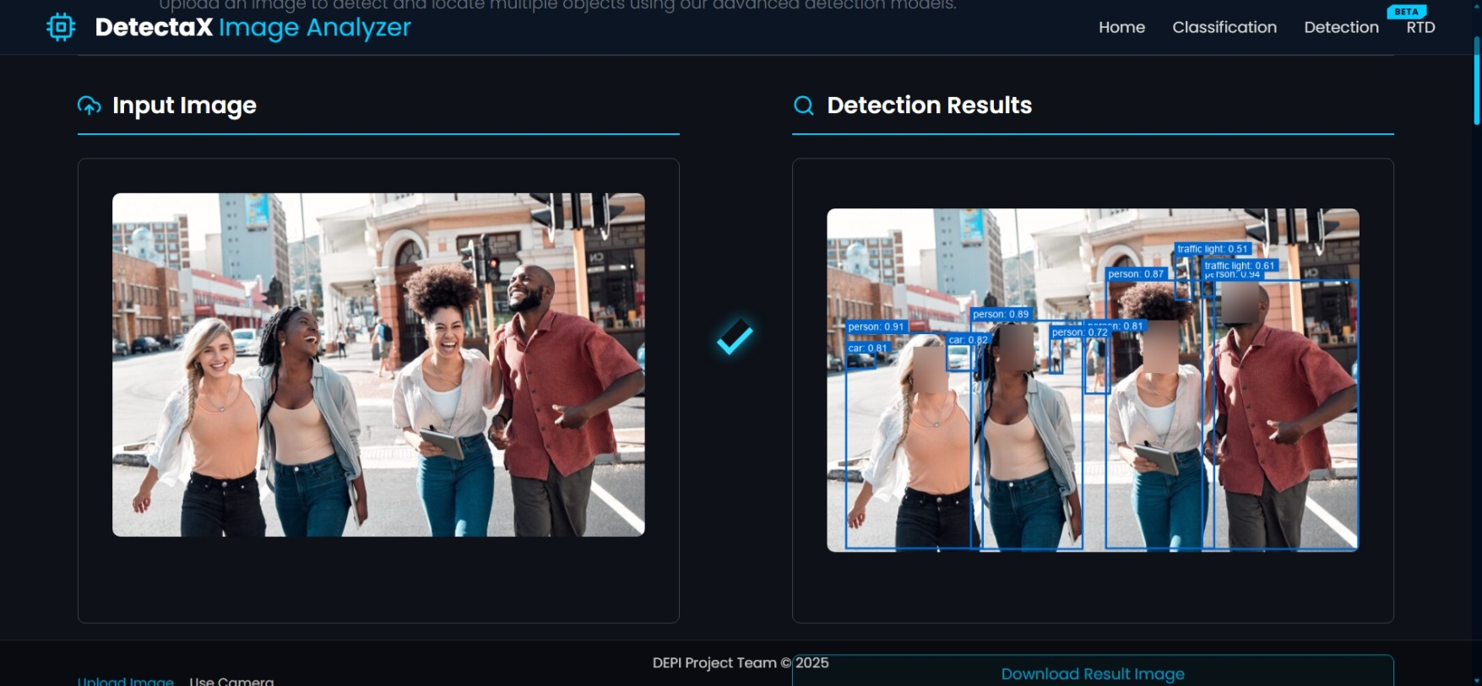
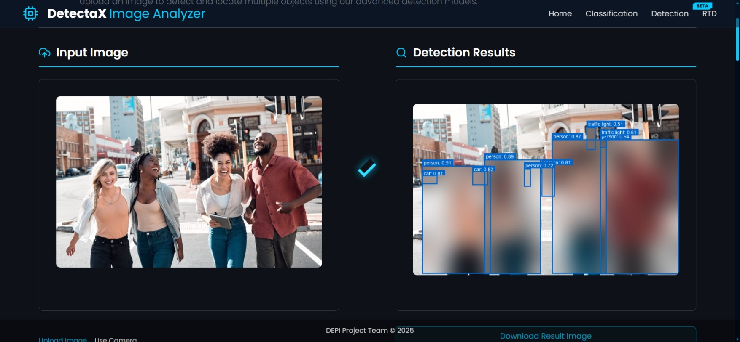
Smart Privacy System
(Blur Faces Only)
(Blur Detected Objects)
Optional privacy modes: face blur and full-person masking.
Utilizes YOLO-Face for accurate face detection.
Selective blurring without affecting full frame.
Available in both static image detection and real-time mode.
11/29/2025

Slide 30
Project Demonstration:
11/29/2025

Slide 31
Technology Stack & Versions
Requests 2.31.0
Matplotlib 3.7.2
Plotly 5.15.0
Kaleido 0.2.1
Ultralytics 8.1.0
Torch 2.1.0
Python 3.12
Streamlit 1.28.0
OpenCV 4.8.1.78
Pillow 10.0.1
NumPy 1.24.3
11/29/2025

Slide 32
Thank You!
11/29/2025

